Slide 1

18ECE340T- MACHINE PERCEPTION WITH COGNITION
UNIT-2
Topics Covered: Boundary descriptors and Region descriptors
Reference Book
Computer and Machine Vision by E.R.Davies
Prepared by
Dr. S.UMA MAHESWARI,
Assistant Professor/ ECE

Slide 2
BOUNDARY DISCRIPTORS AND REGION DISCRIPTORS
BOUNDARY DISCRIPTORS :
Simple Descriptors. q Length of a Contour.
By counting the number of pixels along the contour.
For a chain coded curve with unit spacing in both directions, the number of vertical and horizontal components plus 21/2 times the number of components give the exact length of curve.

Slide 3
REGION DISCRIPTORS
REGION DISCRIPTORS:
In computer vision, visual descriptors or image descriptors are descriptions of the visual features of the contents in images, videos, or algorithms or applications that produce such descriptions.
They describe elementary characteristics such as the shape, the color, the texture or the motion, among others.

Slide 4
Shape Analysis & Measurement
The extraction of quantitative feature information from images is the objective of image analysis.
The objective may be:
shape quantification
count the number of structures
characterize the shape of structures

Slide 5
Shape Measures
The most common object measurements made are those that describe shape.
Shape measurements are physical dimensional measures that characterize the appearance of an object.
The goal is to use the fewest necessary measures to characterize an object adequately so that it may be unambiguously classified.

Slide 6
Shape Measures
The performance of any shape measurements depends on the quality of the original image and how well objects are pre- processed.
Object degradations such as small gaps, spurs, and noise can lead to poor measurement results, and ultimately to misclassifications.
Shape information is what remains once location, orientation, and size features of an object have been extracted.
The term pose is often used to refer to location, orientation, and size.

Slide 7
Shape Descriptors
What are shape descriptors?
Shape descriptors describe specific characteristics regarding the geometry of a particular feature.
In general, shape descriptors or shape features are some set of numbers that are produced to describe a given shape.

Slide 8
Shape Descriptors
The shape may not be entirely reconstructable from the descriptors, but the descriptors for different shapes should be different enough that the shapes can be discriminated.
Shape features can be grouped into two classes:
boundary features and region features.

Slide 9
Distances
The simplest of all distance measurements is that between two specified pixels (x₁,y₁) and (x₂,y₂).
There are several ways in which distances can be defined:
– Euclidean
d = (x − x )² + (y − y )²
1 2 1 2
– Chessboard
d = max ₍ x₁ − x₂ , y₁ − y₂ ₎

Slide 10
Distances
– City-block
d = x₁ − x₂ + y₁ − y₂
Euclidean Chessboard
City-block

Slide 11
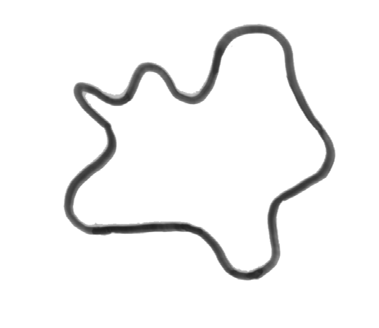
Area
The area is the number of pixels in a shape.
Net Area Convex Area
The convex area of an object is the area of the convex hull that encloses the object.

Slide 12
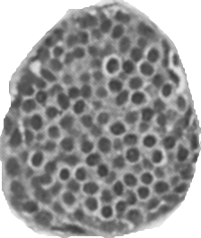
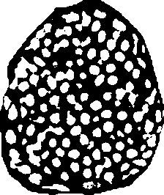

Area
Original Image
Net Area
Filled Area

Slide 13
Perimeter
The perimeter [length] is the number of pixels in the boundary of the object.
– If x₁,…,x_{N} is a boundary list, the perimeter is given by:
N -1 N -1
perimeter = ∑d_{i} = ∑ x_{i}
^{x}i +1
i =1 i =1
– The distances d_{i} are equal to 1 for 4-connected
boundaries and 1 or ₂
boundaries.
for 8-connected

Slide 14
Perimeter
For instance in an 8-connected boundary, the distance between diagonally adjacent pixels is the Euclidean measu₂re
– The number of diagonal links in N₄–N₈, and the remaining N₈–(N₄–N₈) links in the 8-connected boundary are of one pixel unit in length. Therefore the total perimeter is:
perimeter = ( 2 − 1)N₄ + (2 − 2)N₈

Slide 15
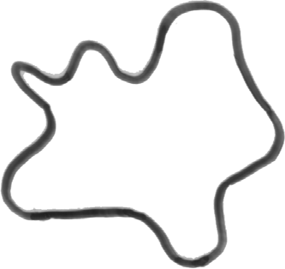
Perimeter
The convex perimeter of an object is the perimeter of the convex hull that encloses the object.
convex perimeter
object perimeter

Slide 16
Major Axis
The major axis is the (x,y) endpoints of the longest line that can be drawn through the object.
– The major axis endpoints (x₁,y₁) and (x₂,y₂) are found by computing the pixel distance between every combination of border pixels in the object boundary and finding the pair with the maximum length.

Slide 17
Major Axis Length
The major-axis length of an object is the pixel distance between the major-axis endpoints and is given by the relation:
major-axis length = ₍ x − x + ₍y
) )
2
y
2
2 1 2 1
– The result is measure of object length.

Slide 18
Major Axis Angle
The major-axis angle is the angle between the major-axis and the x-axis of the image:
− y₁ ⎞
major-axis angle = tan^{−1 ⎛ y2}
⎜ _{x}
x ⎟
⎝ 2 1 ⎠
The angle can range from 0° to 360°.
The result is a measure of object orientation.

Slide 19
Minor Axis
The minor axis is the (x,y) endpoints of the longest line that can be drawn through the object whilst remaining perpendicular with the major-axis.
– The minor axis endpoints (x₁,y₁) and (x₂,y₂) are found by computing the pixel distance between the two border pixel endpoints.

Slide 20
Minor Axis Length
The minor-axis length of an object is the pixel distance between the minor-axis endpoints and is given by the relation:
minor-axis length = ₍ x − x + ₍y
) )
2
y
2
2 1 2 1
– The result is measure of object width.

Slide 21
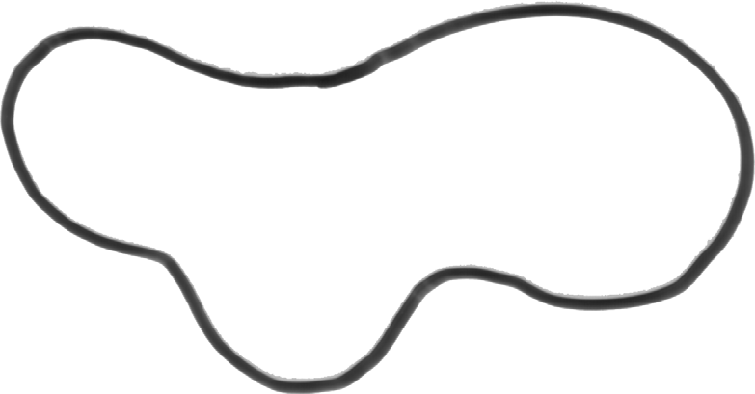
Major and Minor Axes
Major Axis
Minor Axis

Slide 22
Compactness
Compactness is defined as the ratio of the area of an object to the area of a circle with the same perimeter.
4π ⋅ area
compactness =
(perimeter )²
A circle is used as it is the object with the most compact shape.
The measure takes a maximum value of 1 for a
circle
π 4
– A square has compactness =

Slide 23
Compactness
Objects which have an elliptical shape, or a boundary that is irregular rather than smooth, will decrease the measure.
An alternate formulation:
(perimeter )² 4π ⋅ area
compactness =
The measure takes a minimum value of 1 for a circle
Objects that have complicated, irregular boundaries have larger compactness.

Slide 24


Compactness
low compactness
compactness=0.764
compactness=0.668

Slide 25
Elongation
In its simplest form elongation is the ratio between the length and width of the object bounding box:
^{width}bounding-box
elongation =
^{length}bounding-box
The result is a measure of object elongation, given as a value between 0 and 1.
If the ratio is equal to 1, the object is roughly square or circularly shaped. As the ratio decreases from 1, the object becomes more elongated.

Slide 26
Elongation
This criterion cannot succeed in curved regions, for which the evaluation of elongatedness must be based on maximum region thickness.
Elongatedness can be evaluated as a ratio of the region area and the square of its thickness.
The maximum region thickness (holes must be filled if present) can be determined as the number d of erosion steps that may be applie_{a}d_{re}b_{a}efore the
region totally disappe^{e}a^{lo}rs^{n}.^{gation =}
2d²

Slide 27
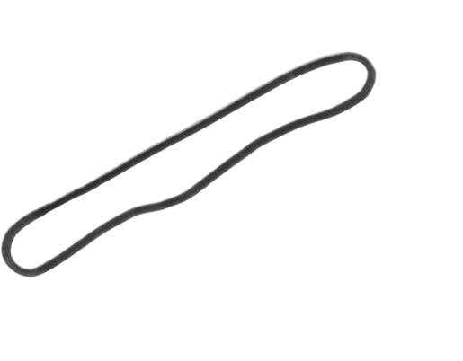
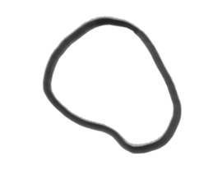
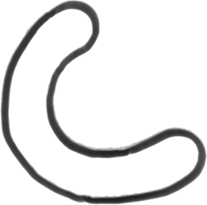
Elongation
lengt^{h}
width
high elongation
low elongation

Slide 28
Eccentricity
Eccentricity is the ratio of the length of the short (minor) axis to the length of the long (major) axis of an object:
axislength_{short}
eccentricity =
axislength_{long}
The result is a measure of object eccentricity, given as a value between 0 and 1.
Sometimes known as ellipticity.

Slide 29
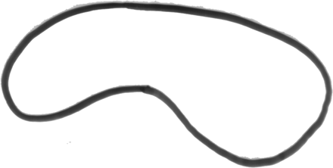
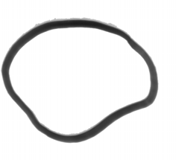
Eccentricity
high eccentricity
low eccentricity

Slide 30
Eccentricity
Eccentricity can also be calculated using central moments:
₎2
₍μ − μ
+ 4μ
eccentricity =
02
20
11
area

Slide 31
Measures of “Circularity”
Sometimes it is useful to have measures that are sensitive only to departures of a certain type of circularity:
e.g.
convexity (measures irregularities) roundness (excludes local irregularities)

Slide 32
Circularity or Roundness
A measure of roundness or circularity (area-to- perimeter ratio) which excludes local irregularities can be obtained as the ratio of the area of an object to the area of a circle with the same convex perimeter:
4π ⋅ area
roundness =
(convex perimeter )²
– This statistic equals 1 for a circular object and less than 1 for an object that departs from circularity, except that it is relatively insensitive to irregular boundaries.

Slide 33
Circularity
roundness=0.584
roundness=0.447

Slide 34
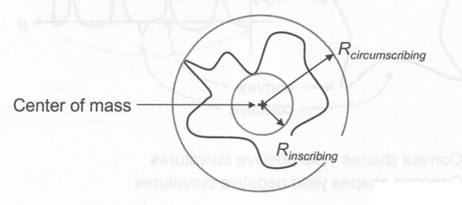
Sphericity
Sphericity measures the degree to which an object approaches the shape of a “sphere”.
^{R}inscribing
sphericity =
^{R}circumscribing
– For a circle, the value is the maximum of 1.0

Slide 35
Convexity
Convexity is the relative amount that an object differs from a convex object.
– A measure of convexity can be obtained by forming the ratio of the perimeter of an object’s convex hull to the perimeter of the object itself:
convex perimeter
convexity =
perimeter

Slide 36
Convexity
– This will take the value of 1 for a convex object, and will be less than 1 if the object is not convex, such as one having an irregular boundary.
convexity=1.0
convexity=0.483
convexity=0.349

Slide 37
Aspect Ratio
The aspect ratio measures the ratio of the objects height to its width.
height
aspect ratio =
width

Slide 38
Caliper Dimensions
Caliper or feret diameters are the distances between parallel tangents touching oppoisite sides of an object.
At orientation θ, the caliper diameter is:
max(x sinθ + y cosθ ) − min (x sinθ + y cosθ )
( x,y )∈A ^{( xy )∈A}
Certain caliper diameters are of special interest:
The width of an object (θ = 0°)
max(y ) − min (y )
( x,y )∈A ^{( x,y )∈A}

Slide 39
Caliper Dimensions
The height of an object (θ = 90°)
max(x) − min (x)
( x,y )∈A ^{( x,y )∈A}
The maximum caliper diameter is one definition of an objects length.

Slide 40

Curl
The curl of an object measures the degree to which an object is “curled up”.
length
curl =
fibre width
fibre length
breadth
length
fiber length

Slide 41
Curl
As the measure of curl decreases, the degree to which they are “curled up” increases.
perimeter- (perimeter)² − 16 ⋅ area
fibre length =
4
area
fibre width =
fibre length

Slide 42
Convex Hull
The convex hull of an object is defined to be the smallest convex shape that contains the object.

Slide 43
Solidity
Solidity measures the density of an object.
A measure of solidity can be obtained as the ratio of the area of an object to the area of a convex hull of the object:
area
solidity =
convex area

Slide 44
Solidity
– A value of 1 signifies a solid object, and a value less than 1 will signify an object having an irregular boundary, or containing holes.
solidity=1.0
solidity=0.782
solidity=0.592

Slide 45
Shape Variances
Sometimes a shape should be compared against a template.
A circle is an obvious and general template choice. The circular variance is the proportional mean-squared error with respect
to solid circle.
It gives zero for a perfect circle and increases along shape complexity and elongation.

Slide 46
Shape Variances
Elliptic variance is defined similarly to the circular variance. An ellipse is fitted to the shape (instead of a circle) and the mean- squared error is measured.

Slide 47
Rectangularity
Rectangularity is the ratio of the object to the area of the minimum bounding rectangle.
– Let F_{k} be the ratio of region area and the area of a bounding rectangle, the rectangle having the direction k. The rectangle direction is turned in discrete steps as before, and rectangularity measured as a maximum of this ratio F_{k}
rectangularity =
max(F_{k} )
k
– Rectangularity has a value of 1 for perfectly rectangular object

Slide 48
Bounding Box
The bounding box or bounding rectangle of an object is a rectangle which circumscribes the object. The dimensions of the bounding box are those of the major and minor axes.
The area of the bounding box is:
area = (major axis length) *(minor axis length)
The minimum bounding box is the minimum area that bounds the shape.

Slide 49
Bounding Box
bounding boxes

Slide 50
Direction
Direction is a property which makes sense in elongated regions only. If the region is elongated, direction is the direction of the longer side of a minimum bounding rectangle.
– If the shape moments are known, the direction θ
can be computed as:
2μ₁₁
⎞
θ = ¹ tan^{−1 ⎛}
⎜ _{μ}
⎟
2
− μ
⎝ 20 02 ⎠

Slide 51
Direction
Elongatedness and rectangularity are independent of linear transformations translation, rotation, and scaling.
Direction is independent on all linear transformations which do not include rotation.
Mutual direction of two rotating objects is rotation invariant.

Slide 52
Orientation
The overall direction of the shape.

Slide 53
Topological Descriptors
Topological properties are useful for global descriptions of objects in an image.
Features that do not change with elastic deformation of the object.
For binary regions, topological features include the number of holes in a region, and the number of indentations, or protrusions.
One topological property is the number of connected components.

Slide 54
Topological Descriptors
The number of holes H and connected components C in an image can be used to define the Euler number.
The Euler number is defined as the number of components minus the number of holes:
Euler number = C - H
This simple topological feature is invariant to translation, rotation and scaling.

Slide 55
Boundary Descriptors
The shape of a region can be represented by quantifying the relative position of consecutive points on its boundary.
A chain code consists of a starting location and a list of directions d₁,d₂,…,d_{N} provides a compact representation of all the information in a boundary.
– The directions d_{i} are estimates of the slope of the boundary.

Slide 56
Boundary Descriptors
Chain codes are based on 4- or 8- connectivity:
3
2
1
4
0
5
6
7
e.g.
2,1,0,7,7,0,1,1

Slide 57
Boundary Descriptors
The k-slope of the boundary at (x_{i},y_{i}) can be estimated from the slope of the line joining (x_{i-k/2},y_{i-k/2}) and (x_{i+k/2},y_{i+k/2}) for some small, even value of k. Calculated as an angle of:
_{tan−1} ^{⎛ y}i +k 2 ^{− y}i −k 2 ⎞
⎜ _{x} ⎟
⎝
x
i −k 2 ⎠
i +k 2
measured in a clockwise direction, with a horizontal slope taken to be zero.

Slide 58
Boundary Descriptors: Curvature
The k-curvature of the boundary at (x_{i},y_{i}) can be estimated from the change in the k-slope:
⎧
⎛
y − y_{i}
⎪
^{− y}i −k ⎞⎫⎪
⎨
tan
−1
⎜ _{x}
i + k
⎞ − tan^{−1 ⎛ yi}
(mod2π )
⎜ _{x}
⎟⎬
⎪⎩
x ⎟
x
⎠⎪⎭
⎝ i + k i ⎠
⎝ i
i −k

Slide 59
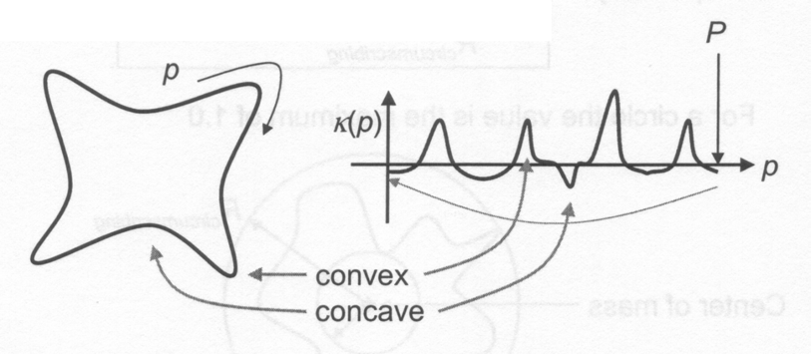
Boundary Descriptors: Curvature
The curvature (κ) of an object is a local shape attribute.
Convex shapes yield positive curvatures
Concave shapes yield negative curvatures

Slide 60
Boundary Descriptors: Bending
Energy
The total bending energy E_{C} is a robust global shape descriptor.
– The bending energy of a boundary may be understood as the energy necessary to bend a rod to the desired shape and can be calculated as a sum-of-squares of the boundary curvature κ(p) over the boundary length L.
L
E =
1
L
∑
κ (p)
2
2π
R
≤ E ≤ ∞
c
c
p =1
– The minimum value 2π/R is obtained for a circle of radius R.

Slide 61
Boundary Descriptors: Bending
Energy
For example:
chain-code: curvature:
sum of squares:
0 0 2 0 1 0 7 6 0 0
0 2 –2 1 –1 –1 –1 2 0
0 4 4 1 1 1 1 4 0
Bending Energy = 16

Slide 62
Total Absolute Curvature
Boundary Descriptors:
This descriptor is a measure of the total absolute curvature in an object:
L
=
1
L
∑
κ (p)
≤ ∞
^{κ} total
^{2π ≤ κ} total
p =1
– The minimum value is found for all convex objects.

Slide 63
Moment Analysis
The evaluation of moments represents a systematic method of shape analysis.
The most commonly used region attributes are calculated from the three low-order moments.
Knowledge of the low-order moments allows the calculation of the central moments, normalised central moments, and moment invariants.

Slide 64
Spatial Moments
To define the (p,q)^{th}-order moment:
M −1 N −1
m = ∑∑ x^{p} y^{q}
for p,q = 0,1,2,...
pq
x =0 y =0
The zero^{th}-order moment m₀₀ simply represents the sum of the pixels contained in an object and gives a measure of the area (because x⁰=y⁰=1)

Slide 65
Spatial Moments
The first-order moments in x (m₁₀) and y (m₀₁) normalised by the area can be used to specify the location of an object:
The centre of gravity, or centroid of an object is a measure of the object’s location in the image.
It has two components, denoting the row and column positions of the point of balance of the object.
⎛ ⎞
( )
m m
centroid = x, y =
⎜ _{m}
10
,
01
⎟
m
⎝ 00 00 ⎠

Slide 66
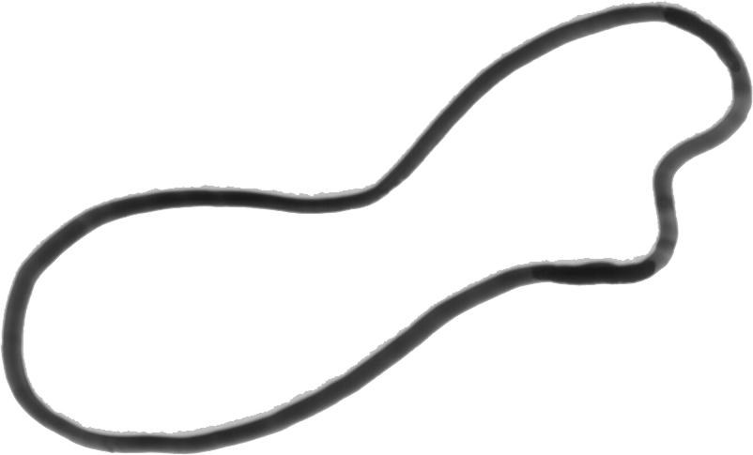
Spatial Moments
y
x, y
θ
x

Slide 67
Central Moments
The central moments^{μ}_{pq} (i.e. p+q >1) represent descriptors of a region that are normalised with respect to location.
M −1 N −1
μ = _{∑ ∑(} x − x ₎^{p} ₍y − y ₎^{q}
x =0 y =0
for p + q > 1
pq

Slide 68
Normalised Central Moments
The central moments can be normalised with respect to the zero^{th} moment to yield the normalised central moment:
_{μ}γ
η = μ
pq pq 00
γ = (p + q) 2 + 1
The most commonly normalised central moment is η₁₁, the first central moment in x and y.
– This provides a measure of the deviation from a circular region shape. A value close to zero describes a region that is close to circular.

Slide 69
Central Moments
Central moments are translation invariant:
i.e. two objects that are identical except for having different centroids, will have identical values of
Central moments are not rotationally invarian_{μ}t_{pq}
Central moments are not rotationally invariant
they will change if an object is rotated.

Slide 70
Central Moments
The second-order central moments:
_{m}2 _{m}2
₋ 10
₋ 01
m m
μ = m
μ = m
₋ 10 01
^{μ}11 ^{= m}11
20 20
m
02 02
m m
00 00 00
The second-order moments measure how dispersed the pixels in an object are from their centroid:
^{μ}₂₀ measures the object’s spread over rows
^{μ}₀₂ measures the object’s spread over columns
^{μ}11 is a cross-product term representing spread in the direction in which both row and column indices increase.

Slide 71
Principal Axes
Principal axes of an object can be uniquely defined as segments of lines crossing each other orthogonally in the centroid of the object and representing the directions with zero cross-correlation. This way, a contour is seen as an realization of a statistical distribution.

Slide 72
Principal Axes
Principal (major and minor) axes are defined to be those axes that pass through the centroid, about which the moment of inertia of the region is, respectively maximal or minimal.
– The orientation of the m⎡ ajo₂r_{μ}axis:⎤
θ = tan
−1
11
1
⎢
⎥
2
μ − μ
⎣ 20 02 ⎦
which is measured clockwise, with the horizontal direction taken as zero.
– This can be used to find the minimum bounding box.
70

Slide 73
Moment Invariants
Normalisation with respect to orientation results in rotationally invariant moments.
– The first two are the following functions of the second-order central moments:
φ₁ = η₂₀ + η₀₂
₎2
φ₂ = ₍η₂₀ − η₀₂ + 4η
2
11
The first of these statistics is the moment of inertia, a measure of how dispersed, in any direction, the pixels in an object are from their centroid.
The second statistic measures whether this dispersion is isotropic or directional.
‹#›

Slide 74
Moment Invariants
φ₁ = η₂₀ + η₀₂
₎2
φ = ₍η − η
+ 4η
2
2
20
02
₎2
11
₎2
φ = ₍η − 3η
+ ₍3η − η
3
30
12
21
03
₎2
₎2
φ = ₍η + η
+ ₍η + η
4
03
12
21
03
‹#›

Slide 75
Central Moments
^{μ}10
= μ₀₁ = 0
^{μ}11 ^{= m}11 ^{− m}10 ^{m}01 ^{m}00
μ = m − m² m
20 10 00
μ = m − m² m
02 01 00
μ
μ
20
02
_{x} 2
= m₃₀ − 3xm₂₀ + 2m₁₀
30
= m − 3ym + 2m y ² 03 02 01
03
μ = m₁₂ − 2ym₁₁ − xm₀₂ + 2m₁₀
_{y} 2
12
μ = m − 2xm − ym + 2m x ² 21 11 20 01
21
‹#›

Slide 76
Radial Distance Measures
The shape of a structure of interest can be determined by analysing its boundary, the variations and curvature of which constitute the information to be quantified.
Transform the boundary into a 1D signal and analysing its structure.
The radial distance is measured from the central point (centroid) in the object to each pixel x(n), y(n) on the boundary.
‹#›

Slide 77
Radial Distance Measures
Generally the centroid is used as the central point, and the radial distance:
d(n) = [x(n) − x ]² + [y(n) − y ]²
is obtained by tracing all
N pixels of the boundary.
n = 0,1,...,N − 1
d
‹#›

Slide 78
Radial Distance Measures
To achieve scale invariance, the normalised radial distance r(n) is obtained by normalising d(n) with the maximal distance
The number of times the signal r(n) crosses its mean and other similar metrics can be used as a measure of boundary roughness.
– Kilday, J., Palmieri, F., and Fox, M.D., “Classifying mammographic lesions using computerized image analysis”, IEEE Transactions on Medical Imaging, 1993, 12: pp.664-669
‹#›

Slide 79
Radial Distance Measures
The sequence r(n) is further analysed to extract shape metrics such as the entropy:
E = ∑h_{k} logh_{k}
k =1
where h_{k} is the k-bin probability histogram that represents the distribution of r(n) as well as the statistical moments:
K
N −1
[ ]
m_{p} =
1
N
∑
n =0
r (n)
p
‹#›

Slide 80
Radial Distance Measures
The central moment:
N −1
[ ]
μ_{p} =
1
N
∑
r (n) − m
p
1
n =0
Normalised moments invariant to translation, rotation and scaling:
₌ m_{p}
₌ μ_{p}
m
μ
p ≠ 2
p
μ
p 2
p
μ
p 2
2
2
‹#›

Slide 81
Fourier Descriptor
The information in the r(n) signal can be further analysed in the spectral domain using the discrete Fourier transform (DFT):
N −1
a(u) =
∑
j 2π nu N
1
N
r (n)e u = 0,1,...,N − 1
n =0
The “low-frequency” terms, correspond to the smooth behavior.
The “high-frequency” terms correspond to the jagged, bumpy behavior € roughness
‹#›

Slide 82
References:
Radial Distance Measures
Pohlman, K.A., Powell, K.A., Obuchowski, N.A., Chilcote, W.A., Grunfest-Bronlatowski, S., “Quantitative classification of breast tumours in digitized mammograms”, Medical Physics, 1996, 23: pp.1337-1345 (masses)
Bruce, L.M., Kallergi, M., “Effects of image resolution and segmentation method on automated mammographic mass shape classification”, Proceedings of the SPIE, 1999, 3661: pp.940-947 (masses)
Kilday, J., Palmieri, F., and Fox, M.D., “Classifying mammographic lesions using computerized image analysis”, IEEE Transactions on Medical Imaging, 1993, 12: pp.664-669 (masses)
Shen, L., Rangayyan, R.M., and Desautels, J.E.L., “Application of shape analysis to mammographic calcifications”, IEEE Transactions on Medical Imaging, 1994, 13: pp.263-274 (calcifications)
‹#›

Slide 83
Contour-based Shape Representation & Description
Object boundaries must be expressed in some mathematical form:
Rectangular (Cartesian) coordinates
Polar coordinates (in which boundary elements are represented as pairs of angle φ and distance r.
y
φ
r
x
‹#›

Slide 84
Fractal Dimension
The fractal dimension is the rate at which the perimeter of an object increases as the measurement scale is reduced.
– The fractal dimension produces a single numeric value that summarizes the irregularity of “roughness” of the feature boundary
‹#›

Slide 85
Fractal Dimension
Richardson dimension
Counting the number of strides needed to “walk” along the boundary, as a function of stride length.
number of steps × stride-length = perimeter measurement
As the stride length is reduced, the path follows more of the local irregularities of the boundary and the measured parameter increases.
The result, plotted on log-log axes is a straight line whose slope gives the fractal dimension.
‹#›

Slide 86
Mammogram Features
Shape descriptors can be used to characterise features extracted from mammograms.
Round
Oval
Lobulated
‹#›

Slide 87
Cell Image Features
When dealing with images containing numerous objects, such as histological or cytological cell images, shape descriptors are calculated for all the individual cells.
Global shape measures can be calculated from the individual image descriptors:
Standard deviation € area, short-axis, long- axis, perimeter, circularity,
Mean € compactness, elongation, perimeter, area
‹#›

Slide 88

Profile
The profile of a binary image analyses the binary image in terms of its projections.
– Projections can be vertical, horizontal, diagonal, circular, radial, spiral.
e.g. used in determining a region of highest density
– A profile is the sum of the pixel values in a specified direction
‹#›

Slide 89
Signature Analysis
A signature is a one-dimensional representation of the boundary.
Computing the distance from the centroid of an object to the boundary as a function of angl from 0°€360° in any chosen increment.
Harmonic analysis, or shape u
The plot repeats every 2π
r
ϕ
es,
nrolling
‹#›

